Slide 1
ANLY 5332
Department of Information Systems and Analytics
McCoy College of Business Administration
Texas State University
Spreadsheet Modeling and LP Applications

Slide 2
Outline
Spreadsheet Modeling (Chapter 2)
  Excel Modeling and Excel Solver (Chapter 2.5)
  Case: Wyndor Glass Co. Product Mix in Excel (Chapter 2.2)
Excel Solver Outputs (not in the textbook)
Transportation and Assignment Models (Chapter 3&15)
Linear Programming Applications (Chapter 3)
  Case: TBA Airlines Procurement (Chapter 3.2)
  Case: Think-Big Capital Budgeting (Chapter 3.2)
  Case: Union Airways Personnel Scheduling (Chapter 3.3)
  Case: Super Grain Advertising-Mix (Chapter 3.4)

Slide 3
Spreadsheet Modeling
Chapter 2

Slide 4
Spreadsheet Modeling
We have discussed how to formulate algebraic models
We have also discussed how to solve simple linear programming models with two decision variables using the graphical solution method
In practice, mathematical models have many more decisions
  Walmart’s distribution, FedEx’s airplane loading/unloading, Investment decisions, etc.
So, we cannot use graphical solution method for many practical problems
One can use software packages
  Once algebraic model is ready, it can be put into different software packages
MS Excel Solver Add-in is sufficient for many practical purposes

Slide 5
Spreadsheet Modeling
Excel Modeling and Excel Solver:
  First, we need to put the model into Excel
  To do so, we can follow similar steps with algebraic modeling
  After we have the Spreadsheet model, we can use Excel Solver Add-in to solve it
  First, let’s put Wyndor Glass Co. Product Mix model into Excel and create a spreadsheet model for it
  Steps to follow for algebraic modeling:
    Step 0: Gather data
    Step 1: Identify the variables
    Step 2: Define the objective function
    Step 3: Define the constraints
  Steps to follow for spreadsheet modeling:
    Step 0: Put the data into Excel
    Step 1: Dedicate cells to variables
    Step 2: Formulate the objective function in a cell
    Step 3: Model the constraints

Slide 6
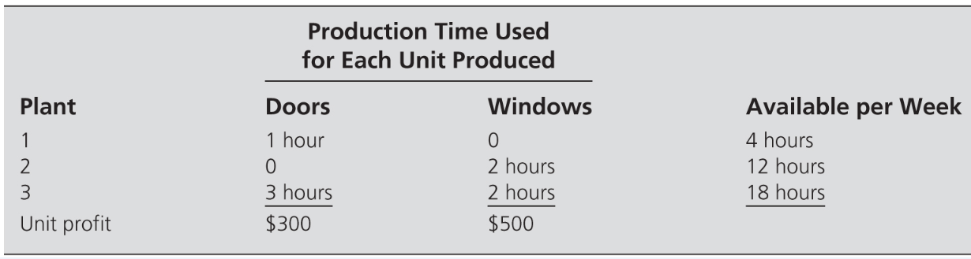
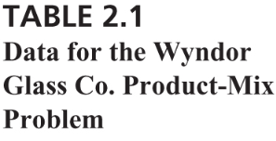
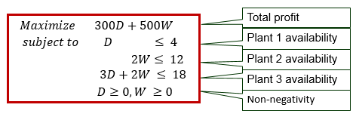
Spreadsheet Modeling
Case: Wyndor Glass Co. Product-Mix Problem (revisited)
  Recall the Wyndor Glass Co. Pruduct-Mix problem, where the company wants to determine how many doors (D) and how many windows (W) to produce per week to maximize weekly profit while not exceeding the limited available time of the plants
  We modeled the problem algebraically:

Slide 7
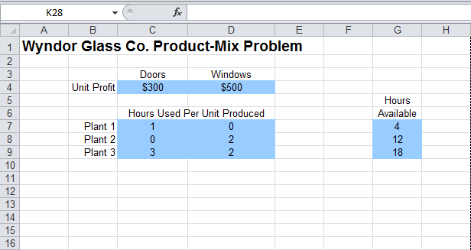
Spreadsheet Modeling
Case: Wyndor Glass Co. Product-Mix Problem in Excel
STEP 0: Put the data into Excel
Use columns and rows effectively to place the data! Title the rows and columns accordingly to easily find which data is where!
Coloring cells will help!
I will use ‘blue’ for data cells!

Slide 8
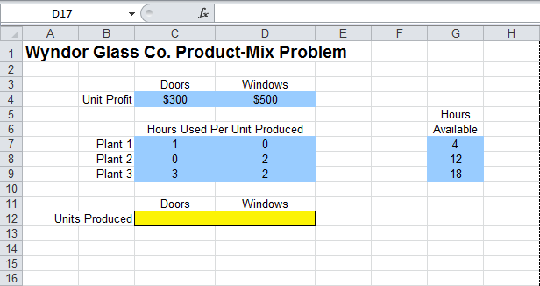
Spreadsheet Modeling
Case: Wyndor Glass Co. Product-Mix Problem in Excel
STEP 1: Dedicate cells to your decision variables
Each decision variables goes into one cell!
Coloring cells will help!
I will use ‘yellow’ for decision variable cells!
D
W

Slide 9
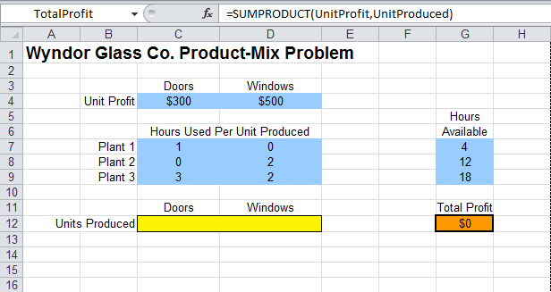
Spreadsheet Modeling
Case: Wyndor Glass Co. Product-Mix Problem in Excel
STEP 2: Formulate the objective function in one cell
Coloring cells will help!
I will use ‘orange’ for the objective function cell!
  Total profit =300D+500W
Ranges can be named as well. For instance, C1:D1 is named ‘UnitProfit’.

Slide 10
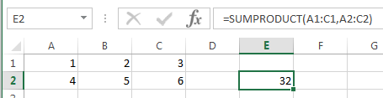
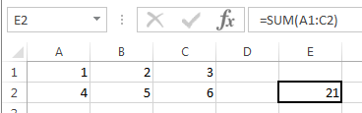
Spreadsheet Modeling
Built-in Excel functions will save you time!
Couple of excel functions that we will often use
  =SUMPRODUCT(Array1, Array2)
    Makes component-wise multiplication and sums the products
    Returns: (1st entry of Array1)*(1st entry of Array2)+(2nd entry of Array1)*(2nd entry of Array2)+(3rd entry of Array1)*(3rd entry of Array2)+…
    Arrays put into the SUMPRODUCT formula should be same dimension, e.g., if Array1 has 1 row and 3 columns, Array 2 should also have 1 row and 3 columns; or if if Array1 has 2 rows and 5 columns, Array 2 should also have 2 rows and 5 columns
  =SUM(Range)
    sums all of the entries in the selected array
=SUMPRODUCT(A1:C1,A2:C2)
= A1*A2+B1*B2+C1*C2
=1*4+2*5+3*6
=32

Slide 11
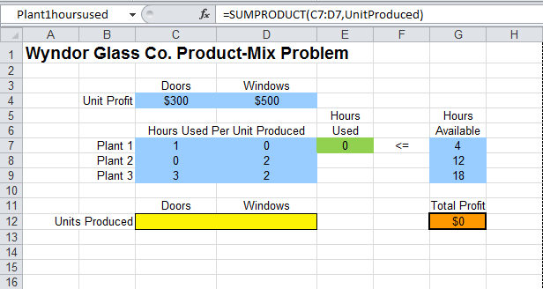
Spreadsheet Modeling
Case: Wyndor Glass Co. Product-Mix Problem in Excel
STEP 3: Model the constraints
  Hours used in Plant 1 =1D
A constraint will be represented in 3 cells! One cell for the left-hand-side, one cell for the inequality or equality, and one cell for the right-hand-side of the constraint.

Slide 12
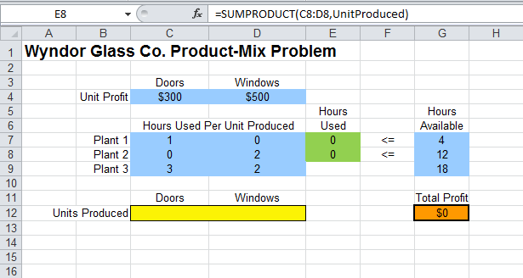
Spreadsheet Modeling
Case: Wyndor Glass Co. Product-Mix Problem in Excel
STEP 3: Model the constraints
  Hours used in Plant 2 =2W

Slide 13
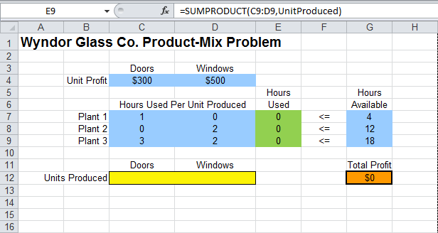
Spreadsheet Modeling
Case: Wyndor Glass Co. Product-Mix Problem in Excel
STEP 3: Model the constraints
  Hours used in Plant 3 =3D+2W

Slide 14
Spreadsheet Modeling
Case: Wyndor Glass Co. Product-Mix Problem in Excel
And the spreadsheet model is:

Slide 15
Spreadsheet Modeling
Excel Modeling and Excel Solver:
  After we have the Spreadsheet model, we can use Excel Solver Add-in to solver it
  First, we need to add the Solver Add-in, if it is not already there
  To do so:
    Open an Excel file and go to ‘File’ tab, then click on ‘Options’
    On the Options Window, select ‘Add-Ins’ on the left menu
    After Add-Ins is selected, select ‘Excel Add-Ins’ from the ‘Manage’ menu at the bottom
    Then, click ‘Go’ next to the Manage menu, and Add-Ins window will open
    Check ‘Solver Add-In’ and click ‘ok’
    Solver will be under Data tab on the right
    See https://www.solver.com/excel-solver-how-load-or-start-solver for different setups

Slide 16

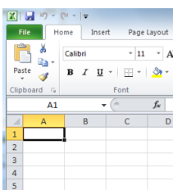

Spreadsheet Modeling
Excel Modeling and Excel Solver:
  Adding Solver Add-In:

Slide 17
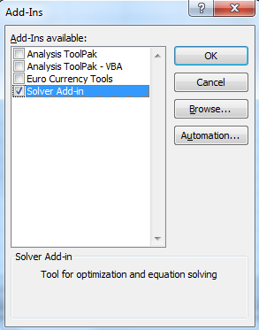
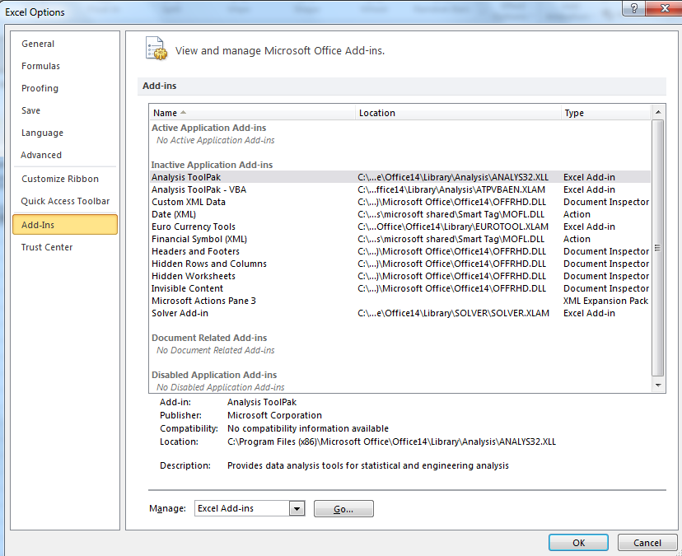
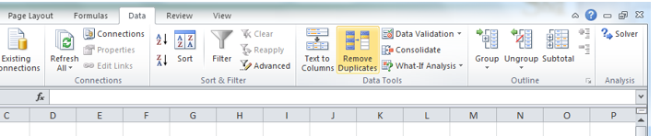
Spreadsheet Modeling
Excel Modeling and Excel Solver:
  Adding Solver Add-In:

Slide 18
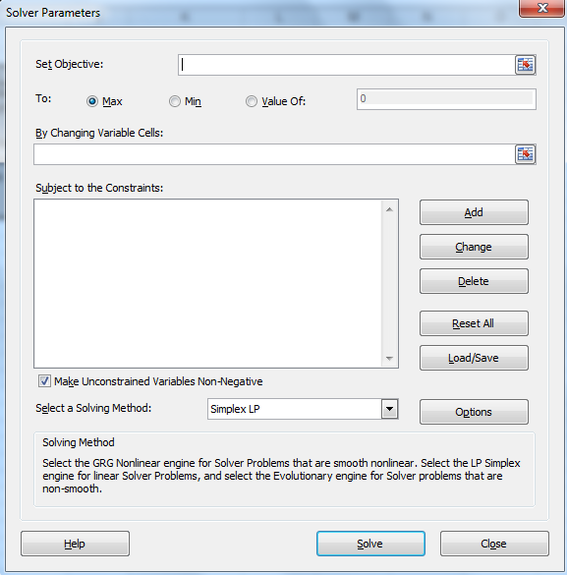
Spreadsheet Modeling
Excel Modeling and Excel Solver:
  Using Solver Add-In:
    Once you click on ‘Solver’
    under the Data tab,
    Solver window will show
    First, pick the objective function cell in
    ‘Set objective:’ row
    Then, pick the objective ‘To:’
      Either Max or Min
    Then, enter the cells dedicated
    to your decision variables in
    ‘By Changing Variable Cells:’ row
      You can enter each cell one by one separated with a
      comma or select all decision cells at once
Pick the cell where your objective function is defined
Pick your objective
Click here to add a constraint..
A new window will pop up
Pick the cells where your decision variables are defined

Slide 19
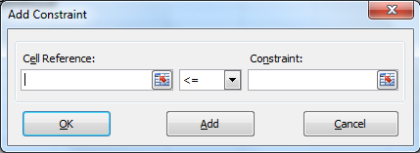
Spreadsheet Modeling
Excel Modeling and Excel Solver:
  Using Solver Add-In:
    Once you click on ‘Add’
    to add a constraint, a new
    window will show
    After entering, you can
    click ‘Ok’ to return to Solver window
    Or, click ‘Add’ to add more constraints
    If you have arrays of same type constraints, you can add them at once as well
Enter the cell where left hand side of your constraint is defined
Choose the inequality type you have
Enter the cell where right hand side of your constraint is defined

Slide 20
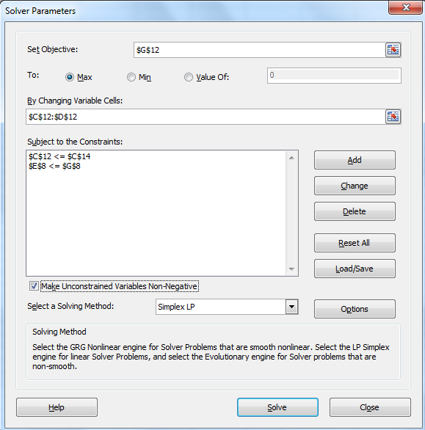
Spreadsheet Modeling
Excel Modeling and Excel Solver:
  Using Solver Add-In:
    Check ‘Make Unconstrained Variables Non-Negative’
    box if your variables are non-negative;
    otherwise, uncheck the box
    From ‘Select a Solving Method’,
    pick ‘Simplex LP’ if your model is linear
      Later, we will see other methods too!
Non-negativity constraints by default
Pick Simplex LP method
Solve it!!!

Slide 21
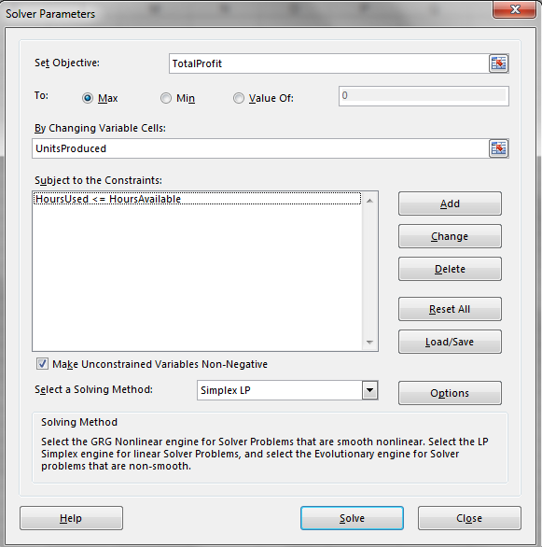
Spreadsheet Modeling
Case: Wyndor Glass Co. Product-Mix Problem solution with Solver
We have the spreadsheet model put into Solver
  Click on ‘Solve’ on Solver window after putting the model into Solver

Slide 22
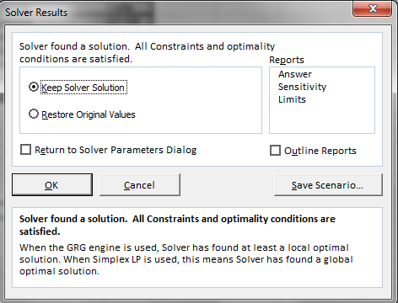
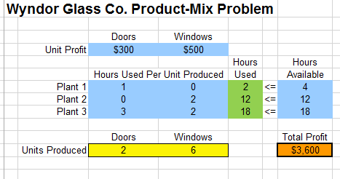
Spreadsheet Modeling
Case: Wyndor Glass Co. Product-Mix Problem solution with Solver
‘Solver Results’ window will pop up! Click ‘OK’ to see the solved model!
The values in the decision variable cells changed! This is the optimal solution!

Slide 23
Excel Solver Outputs

Slide 24
Excel Solver Outputs
Recall that a linear programming model may have four cases:
  Unique optimum
  Alternative optima
  Infeasibility
  Unboundedness
Next, we will discuss how Solver output changes for different cases
To do so, Wyndor Glass Co. Product Mix case will be modified to demonstrate different cases

Slide 25
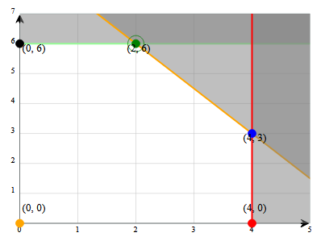




Excel Solver Outputs
Wyndor Glass Co. problem with unique optimum:
Consider the original Wyndor model
We know from the graphical solution method that there exists a unique optimum
  $$Maximize 300D+500W$$
$$subject to D ≤ 4$$
$$2W≤ 12$$
  $3D+2W ≤ 18$
(2,6) is the unique optimum
  $D≥0, W ≥0$

Slide 26
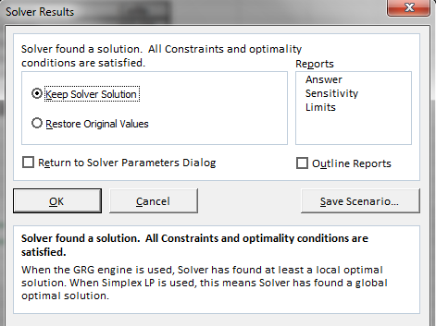
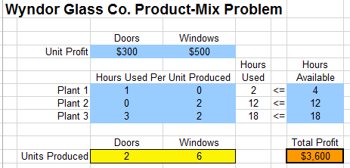
Excel Solver Outputs
Wyndor Glass Co. problem with unique optimum:
Consider the original Wyndor model in spreadsheet
  The solver says
    “Solver found a solution. All constraints and optimality conditions are satisfied”
    This means that the returned solution is an optimum solution when Simplex LP is used
    But, Solver did not tell us if this is the unique optimum or we have alternative optima

Slide 27
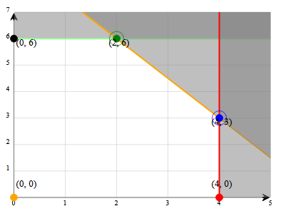




Excel Solver Outputs
Wyndor Glass Co. problem with alternative optima:
Consider the Wyndor model such that the unit profit for windows is $200 instead of $500 (everything else in the model is the same)
  In this case, we can show that (D=2, W=6) and (D=4, W=3) are the two corner point solutions which are both optimum, thus, we have alternative optima
  $$Maximize 300D+200W$$
$$subject to D ≤ 4$$
$$2W≤ 12$$
  $3D+2W ≤ 18$
(2,6) and (4,3) and everything in between are optimum
  $D≥0, W ≥0$

Slide 28
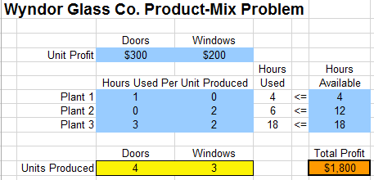
Excel Solver Outputs
Wyndor Glass Co. problem with alternative optima:
Consider the Wyndor model such that the unit profit for windows is $200 instead of $500 (everything else in the model is the same)
  In this case, we can show that (D=2, W=6) and (D=4, W=3) are the two corner point solutions which are both optimum, thus, we have alternative optima
  The solver says the same thing!
    “Solver found a solution. All constraints and optimality conditions are satisfied”

Slide 29
Excel Solver Outputs
When the Solver says
“Solver found a solution. All constraints and optimality conditions are satisfied”
it means that Solver found an optimum solution
Indeed, when our model is a linear programming
model and we use ‘Simplex LP’ to solve it:
  Excel Solver will find an optimum solution
  if there exists one
  However, it will not tell if it is the unique optimum
  solution or it is one of the alternative optimum
  solutions

Slide 30
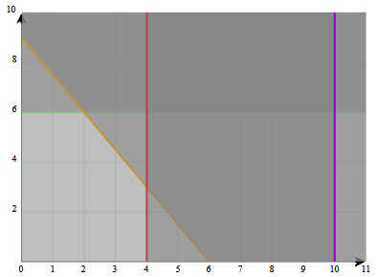





Excel Solver Outputs
Wyndor Glass Co. problem with infeasibility:
Consider the original Wyndor model with the additional restriction that we should produce at least 10 doors per week
  That is, we will add D>=10 as a new constraint to the model
  Originally, we had D<=4, thus, the new constraint makes the model infeasible
  $$Maximize 300D+500W$$
$$subject to D ≤ 4$$
$$2W≤ 12$$
  $3D+2W ≤ 18$
  $D ≥10$
  $D≥0, W ≥0$

Slide 31
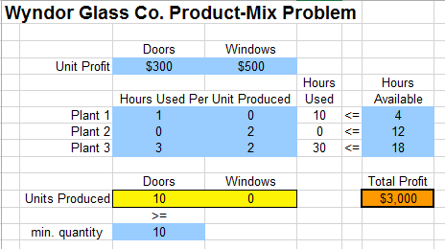
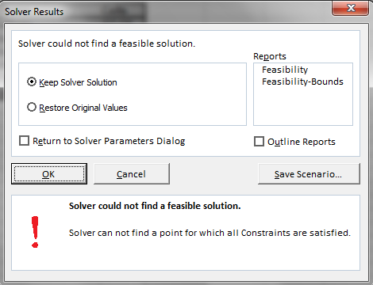
Excel Solver Outputs
Wyndor Glass Co. problem with infeasibility:
Consider the original Wyndor model with the additional restriction that we should produce at least 10 doors per week
  That is, we will add D>=10 as a new constraint to the model
  Originally, we had D<=4, thus, the new constraint makes the model infeasible
  The solver says “Solver could not find a feasible solution”
    This means that the model is infeasible, and the Solver returns a random infeasible solution!

Slide 32
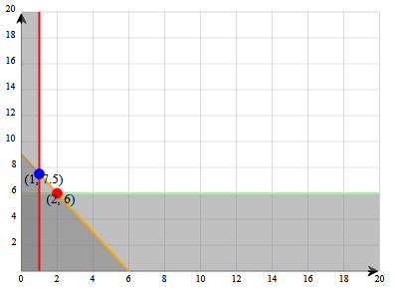



Excel Solver Outputs
Wyndor Glass Co. problem with unboundedness:
Consider the original Wyndor model but suppose that we have unlimited hours available in the plants and we need to use at least 1 hour from each
  This makes the model unbounded as we would always increase D and W to continuously increase the weekly profit
  $$Maximize 300D+500W$$
$$subject to D ≥1$$
$$2W≥ 1$$
  $3D+2W≥ 1$
  $D≥0, W ≥0$

Slide 33
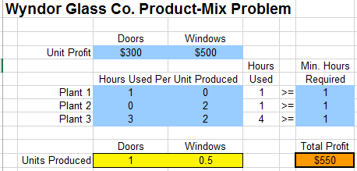
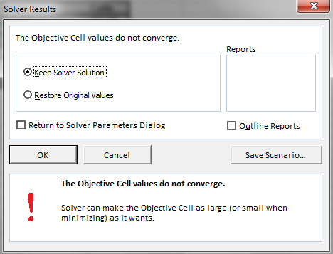
Excel Solver Outputs
Wyndor Glass Co. problem with unboundedness:
Consider the original Wyndor model but suppose that we have unlimited hours available in the plants and we need to use at least 1 hour from each
  This makes the model unbounded as we would always increase D and W to continuously increase the weekly profit
  The solver says “The Objective Cell values do not converge”
    This means that the model is unbounded, and the Solver returns a random feasible solution!

Slide 34

Excel Solver Outputs
Summary:
  When the Solver says “Solver found a solution. All constraints and optimality conditions are satisfied”,
    It means that the model either has a unique optimum solution or alternative optima
    The solution returned by the Solver is an optimum solution
  When the Solver says, “Solver could not find a feasible solution”,
    It means that the model is infeasible, thus there is no optimal solution
    The solution returned by the Solver is a random infeasible solution
  When the Solver says, “The Objective Cell values do not converge”,
    It means that the model is unbounded, thus there is no optimal solution
    The solution returned by the Solver is a random feasible solution

Slide 35
Linear Programming Applications
Chapter 3

Slide 36
Linear Programming Applications
Linear programming has many applications in practice!
  Read the ‘Application Vignette’s in the textbook
Though not needed, one can describe different problem categories
  Transportation problems
    Minimize cost (typically) while making sure shipments are made correctly
  Assignment problems
    Make assignments (people to jobs, machines to jobs, classes to courses, etc.)
  Resource-allocation problems
    Allocate resources to activities to achieve the best outcome
  Cost-benefit-tradeoff problems
    Minimize cost while assuring a certain level of benefits by decision on level of activities
  And mixed problems

Slide 37
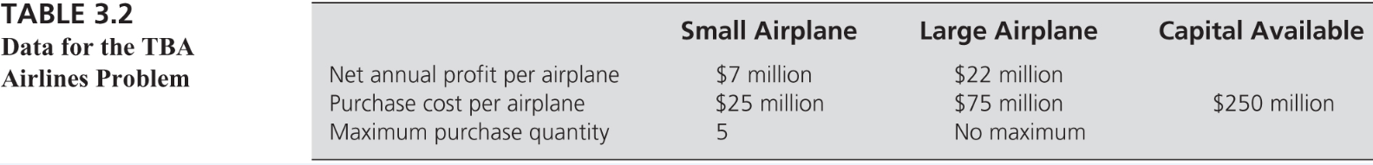
Linear Programming Applications
Case: TBA Airlines Problem (Chapter 3.2)
  Case Description: TBA Airlines is a small regional company that specializes in short flights in small airplanes.
  The company has been doing well and has decided to expand its operations.
  The basic issue facing management is whether to purchase more small airplanes to add some new short flights, or start moving into the national market by purchasing some large airplanes, or both.
  Question: How many airplanes of each type should be purchased to maximize their total net annual profit?
STEP 0: Know the problem and gather your data

Slide 38
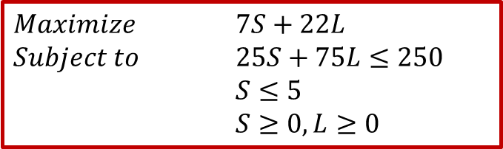
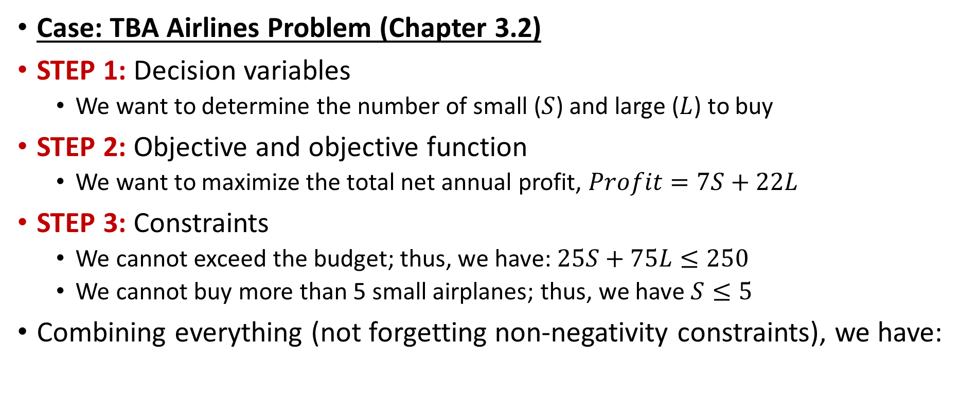
Linear Programming Applications
Case: TBA Airlines Problem (Chapter 3.2)
STEP 1: Decision variables
  We want to determine the number of small ($S$) and large ($L$) to buy
STEP 2: Objective and objective function
  We want to maximize the total net annual profit, $Profit=7S+22L$
STEP 3: Constraints
  We cannot exceed the budget; thus, we have: $25S+75L≤250$
  We cannot buy more than 5 small airplanes; thus, we have $S≤5$
Combining everything (not forgetting non-negativity constraints), we have:
$Maximize$ $7S+22L$
$Subject to$ $25S+75L≤250$
$S≤5$
$S≥0, L≥0$

Slide 39
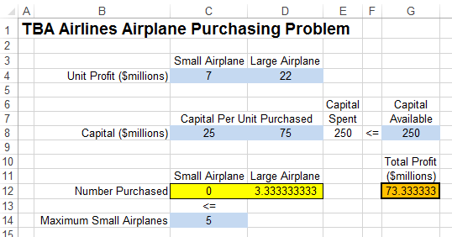
Linear Programming Applications
Case: TBA Airlines Problem (Chapter 3.2)
Spreadsheet model and solution with Excel Solver
  Solver returned fractional values, which is possible because we did not tell it not to return fractional values
    In practice, this solution would be problematic, and we would want the decision variables to take only integer values

Slide 40
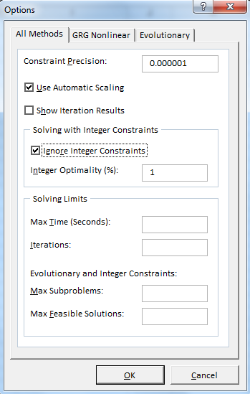
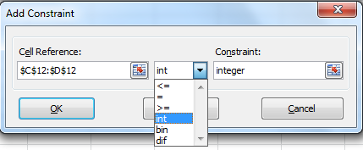
Linear Programming Applications
Integer variables with Solver:
You can force your decision variables to be integer
  Since this is a restriction, this will be enforced
  by adding constraints
On Solver window, click on ‘Options’ and ‘Options’ window will show
Pick the decision variables that should be integer
Pick ‘int’ and the constraint will be added
Uncheck
Click OK

Slide 41
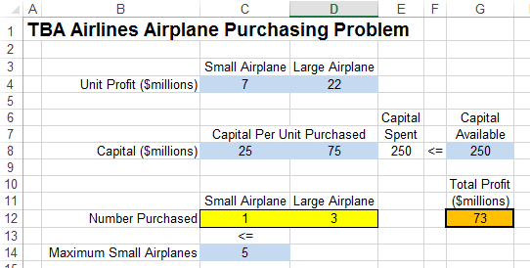
Linear Programming Applications
Case: TBA Airlines Problem (Chapter 3.2)
Spreadsheet model and the integer solution with Excel Solver

Slide 42

Linear Programming Applications
Resource Allocation Problems:
  There is a set of activities under consideration with different contributions
  There is a set of resources with limited availability
    Each activity (variable) has a profit (contribution) and uses a specific amount of each resource
    How much of each activity you should choose to maximize your profit?
      Surviving in an island example and Wyndor Glass Co. product mix case
Project for Tennessee Department Of Transportation
  Upgrade railroad-highway crossings
    Flashing lights or gates (more countermeasures)
    Every crossing has different risk value and there is limited budget for upgrades
    Which countermeasure should be implemented at which crossing so that maximum risk reduction is achieved under the given budget?
  Konur, D., Golias, M.M., Darks, B. 2013. A Mathematical Modeling Approach to Resource Allocation for Railroad-Highway Crossing Safety Upgrades. Accident Analysis and Prevention 51, 192-201.

Slide 43
Linear Programming Applications
Case: Think-Big Development Co. Capital Budgeting Problem (Chapter 3.2)
  Case Description: Think-Big Development Co. is a major investor in commercial real-estate development projects. They are considering three large construction projects
    Construct a high-rise office building.
    Construct a hotel.
    Construct a shopping center.
  Each project requires each partner to make four investments:
    a down payment now, and additional capital after one, two, and three years.
  Question: At what fraction should Think-Big invest in each of the three projects?

Slide 44
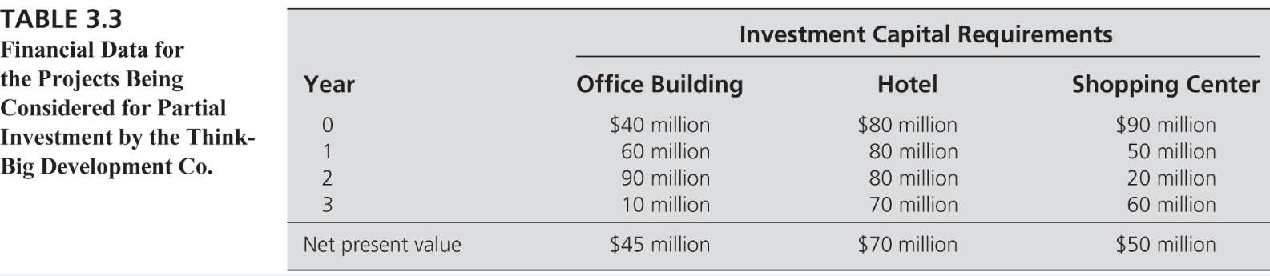
Linear Programming Applications
Case: Think-Big Development Co. Capital Budgeting Problem (Chapter 3.2)
STEP 0: Know the problem and gather your data
  The company currently has $25M and $20M, $20M and $15M will become available after 1, 2, and 3 years, respectively.
  Funds that are not used in a year will be available next year
    Therefore, we should consider the cumulative availability at the end of each period!!

Slide 45
Linear Programming Applications
Case: Think-Big Development Co. Capital Budgeting Problem (Chapter 3.2)
STEP 1: Decision variables
  We want to determine the fraction to invest in each project
  OB: fraction invested in office buildings
  H: fraction invested in hotels
  SC: fraction invested in shopping center
STEP 2: Objective and objective function
  We want to maximize the total net present value
  Maximize NPV = 45OB + 70H + 50SC

Slide 46
Linear Programming Applications
Case: Think-Big Development Co. Capital Budgeting Problem (Chapter 3.2)
STEP 3: Constraints
  We have cash-flow requirements: available money by the end of a year should be at least as much as the required payment by the end of that year
    That is, cash_required <= cash_available for each year
  For year 0 (i.e, now), we have $25 million available, and the total down payment we need to make is equal to 40OB + 80H + 90SC, thus we have
  40OB + 80H + 90SC ≤ 25
  For year 1, we will have $20 million coming in and any money left from year 0, and the payment we need to make is equal to 60OB + 80H + 50SC, thus we have
  60OB + 80H + 50SC ≤ 20+ [25 – (40OB + 80H + 90SC )]
  100OB + 160H + 140SC ≤ 45
Payment to make at the end of year 1
Money coming in year 1
Money left from year 0

Slide 47
Linear Programming Applications
Case: Think-Big Development Co. Capital Budgeting Problem (Chapter 3.2)
STEP 3: Constraints
  For year 2, we will have $20 million coming in and any money left from year 1, and the payment we need to make is equal to 90OB + 80H + 20SC, thus we have
  90OB + 80H + 20SC ≤ 20+ [45 – (100OB + 160H + 140SC )]
  For year 3, we will have $15 million coming in and any money left from year 2, and the payment we need to make is equal to 10OB + 70H + 60SC, thus we have
  10OB + 70H + 60SC ≤ 15+ [65 – (190OB + 240H + 160SC )]
  190OB + 240H + 160SC ≤ 65
Payment to make at the end of year 2
Money coming in year 2
Money left from year 1
  200OB + 310H + 220SC ≤ 80
Payment to make at the end of year 3
Money coming in year 3
Money left from year 2

Slide 48
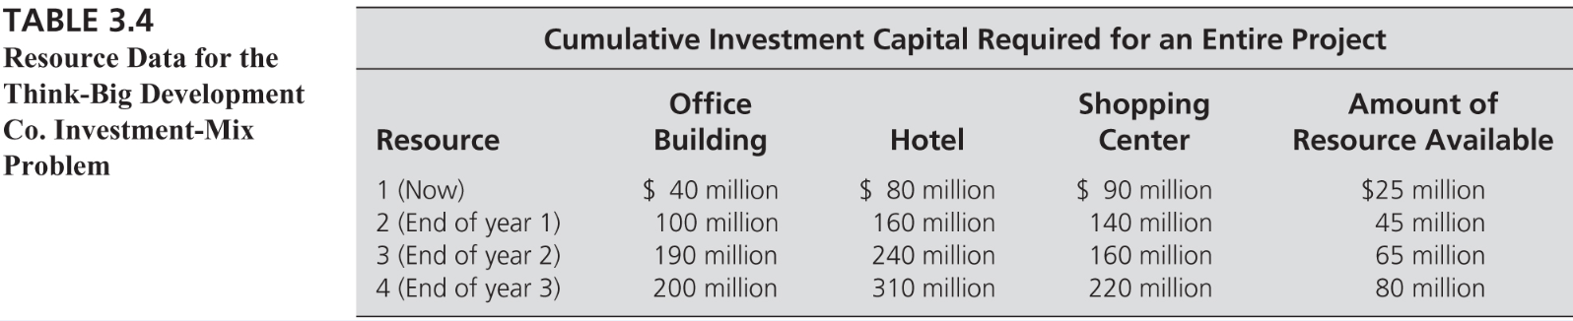
Linear Programming Applications
Case: Think-Big Development Co. Capital Budgeting Problem (Chapter 3.2)
Combining everything (not forgetting non-negativity constraints), we have:
Maximize 45OB + 70H + 50SC
subject to 40OB + 80H + 90SC ≤ 25
100OB + 160H + 140SC ≤ 45
190OB + 240H + 160SC ≤ 65
200OB + 310H + 220SC ≤ 80
OB ≥ 0, H ≥ 0, SC ≥ 0.

Slide 49
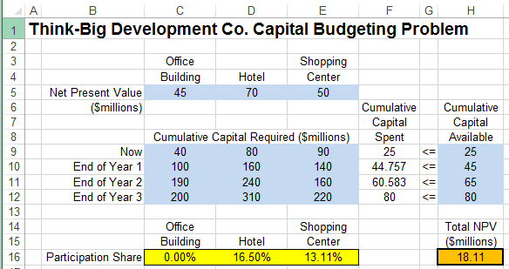
Linear Programming Applications
Case: Think-Big Development Co. Capital Budgeting Problem (Chapter 3.2)
Spreadsheet model and the solution with Excel Solver

Slide 50
Linear Programming Applications
Case: Union Airways Personnel Scheduling Problem (Chapter 3.3)
  Case Description: Union Airways is adding more flights to and from its hub airport and so needs to hire additional customer service agents
  The five authorized eight-hour shifts are
    Shift 1: 6:00 AM to 2:00 PM
    Shift 2: 8:00 AM to 4:00 PM
    Shift 3: Noon to 8:00 PM
    Shift 4: 4:00 PM to midnight
    Shift 5: 10:00 PM to 6:00 AM
  Question: How many agents should be assigned to each shift so that the number of available agents during each time period is at least the minimum number required?

Slide 51
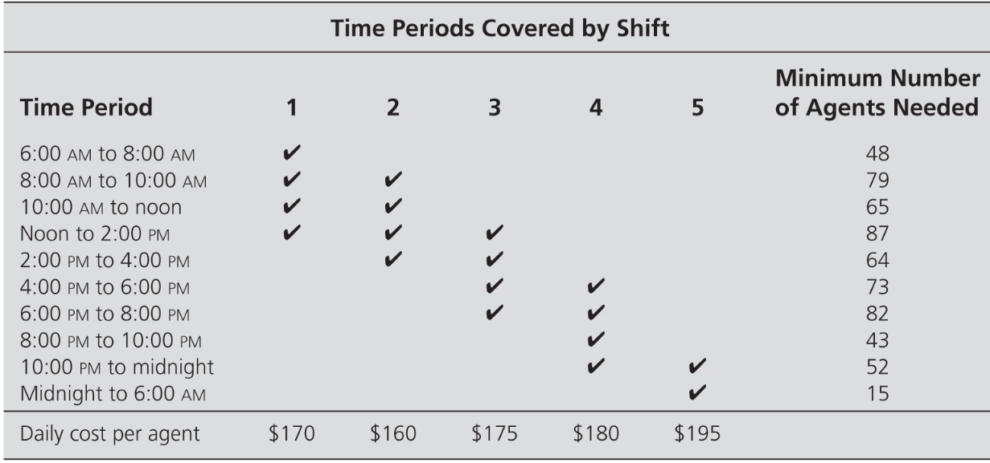
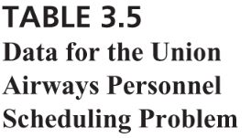
Linear Programming Applications
Case: Union Airways Personnel Scheduling Problem (Chapter 3.3)
STEP 0: Know the problem and gather your data
  We know the shifts, and the time periods, minimum number of agents needed for each time period, and cost of an agent hired under each shift are given as:
√ mark in the table means that an agent working in the corresponding shift will be available during the corresponding time period.

Slide 52
Linear Programming Applications
Case: Union Airways Personnel Scheduling Problem (Chapter 3.3)
STEP 1: Decision variables
  We want to determine the number of agents to hire for each shift
  S_{i} = Number of agents to assign to shift i (for i = 1 to 5)
STEP 2: Objective and objective function
  We want to minimize the total cost of the agents
  Cost = $170S₁ + $160S₂ + $175S₃ + $180S₄ + $195S₅
STEP 3: Constraints
  Total number of agents available during each time period should be >= the minimum number of agents needed during that time period
    One for each time period
    For instance, for 12pm-2pm, at least 87 agents needed & agents in shifts 1, 2, and 3 are available
    Thus, we have S₁ + S₂ + S₃ ≥ 87 as the constraint for time period 12pm-2pm

Slide 53
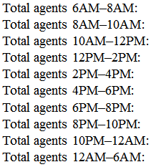
Linear Programming Applications
Case: Union Airways Personnel Scheduling Problem (Chapter 3.3)
Combining everything (and not forgetting non-negativity constraints), we have the algebraic model as follows:
  Minimize $170S₁ + $160S₂ + $175S₃ + $180S₄ + $195S₅
  subject to S₁ ≥ 48
  S₁ + S₂ ≥ 79
  S₁ + S₂ ≥ 65
  S₁ + S₂ + S₃ ≥ 87
  S₂ + S₃ ≥ 64
  S₃ + S₄ ≥ 73
  S₃ + S₄ ≥ 82
  S₄ ≥ 43
  S₄ + S₅ ≥ 52
  S₅ ≥ 15
  S_{i} ≥ 0 (for i = 1 to 5)
Objective function
Constraints
Non-negativity constraints

Slide 54
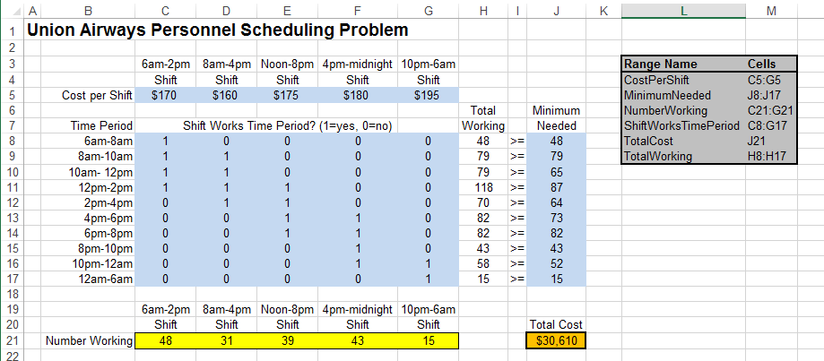
Linear Programming Applications
Case: Union Airways Personnel Scheduling Problem (Chapter 3.3)
Spreadsheet model and solution with Excel Solver
√ mark of Table 3.5 (see slide 26) is represented by 1 in the binary matrix in the Excel model

Slide 55
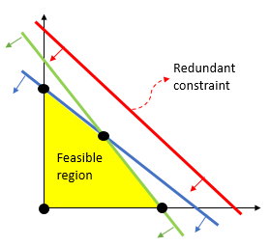
Linear Programming Applications
Redundant Constraints:
Recall the algebraic model for Union Airways (slide #28)
  The 2nd constraint is S₁ + S₂ ≥ 79
  The 3rd constraint is S₁ + S₂ ≥ 65
    The 3rd constraint is already implied by the 2nd constraint
    The 3rd constraint is a redundant constraint!
  Adding or removing a redundant constraint
  does not change the feasible region,
  therefore, it will not change the optimal solution

Slide 56
Linear Programming Applications
Case: Super Grain Advertising-Mix Problem (Chapter 3.4)
  Case Description: Super Grain Corp. wants to design an advertising campaign to maximize exposure to their new product Crunchy Start. They are considering three advertising media
    Television commercials on Saturday morning programs for children.
    Advertisements in food and family-oriented magazines.
    Advertisements in Sunday supplements of major newspapers.
  Each unit of media: results in an exposure to children and parents, has an ad cost, and has a planning cost
  Limited budget for ad spending, planning costs, limited television spots
  Required minimum number of exposure young children and parents
  Fixed amount to spend on coupons in the magazine and newspaper advertisements
  Question: At what level should Super Grain advertise in each of the three media?

Slide 57
Linear Programming Applications
Case: Super Grain Advertising-Mix Problem (Chapter 3.4)
STEP 0: Know the problem and gather your data
 |  | Costs
Cost Category | Each TV Commercial | Each Magazine Ad | Each Sunday Ad
Ad Budget | $300,000 | $150,000 | $100,000
Planning budget | 90,000 | 30,000 | 40,000
Expected number of exposures | 1,300,000 | 600,000 | 500,000
 | Number Reached in Target Category (millions)
 | Each TV Commercial | Each Magazine Ad | Each Magazine Ad | Each Sunday Ad | Minimum Acceptable Level
Young children | 1.2 | 0.1 | 0.1 | 0 | 5
Parents of young children | 0.5 | 0.2 | 0.2 | 0.2 | 5
 | Contribution Toward Required Amount
 | Each TV Commercial |  | Each Magazine Ad | Each Sunday Ad | Required Amount
Coupon redemption | 0 |  | $40,000 | $120,000 | $1,490,000
At most 5 TV spots are available!

Slide 58
Linear Programming Applications
Case: Super Grain Advertising-Mix Problem (Chapter 3.4)
STEP 1: Decision variables
  We want to determine the level to advertise in each of the three media
  TV = Number of commercials for separate spots on television
  M = Number of advertisements in magazines.
  SS = Number of advertisements in Sunday supplements.
STEP 2: Objective and objective function
  We want to maximize the total exposure
  Maximize Exposure = 1,300TV + 600M + 500SS

Slide 59
Linear Programming Applications
Case: Super Grain Advertising-Mix Problem (Chapter 3.4)
STEP 3: Constraints
  We have budget constraints
    Ad Spending: 300TV + 150M + 100SS ≤ 4,000 ($thousand)
    Planning Cost: 90TV + 30M + 30SS ≤ 1,000 ($thousand)
  Limit on the number of TV spots: TV ≤ 5
  Required minimum level of exposure to children and families
    Young children: 1.2TV + 0.1M ≥ 5 (millions)
    Parents: 0.5TV + 0.2M + 0.2SS ≥ 5 (millions)
  Coupons: 40M + 120SS = 1,490 ($thousand)

Slide 60
Linear Programming Applications
Case: Super Grain Advertising-Mix Problem (Chapter 3.4)
Combining everything (and not forgetting non-negativity constraints), we have the algebraic model as follows:
Maximize 1,300TV + 600M + 500SS
subject to 300TV + 150M + 100SS ≤ 4,000
90TV + 30M + 40SS ≤ 1,000
TV ≤ 5
1.2TV + 0.1M ≥ 5
0.5TV + 0.2M + 0.2SS ≥ 5
40M + 120SS = 1,490
TV ≥ 0, M ≥ 0, SS ≥ 0.

Slide 61
Linear Programming Applications
Case: Super Grain Advertising-Mix Problem (Chapter 3.4)
Spreadsheet model and solution with Excel Solver

Slide 62
Transportation and Assignment Models
Chapter 3&15

Slide 63
Transportation Problems
Transportation problems are seen in many applications that deal with transporting goods optimally
  However, many other problems that are not related to transportation can also be modeled as transportation problems
Typically:
  There are sources and destinations
    Each source has a fixed supply of units, where this supply is to be distributed to the destinations.
    Each destination has a fixed demand for units, where this demand must be received from the sources.
  It is assumed that there is a direct way of shipping from any source to any destination
  A transportation problem will have feasible solutions if and only if the sum of its supplies is greater than or equal to the sum of its demands. Traditionally, total supply = total demand, but not needed.
  The cost of distributing units from any particular source to any particular destination is directly proportional to the number of units distributed.
    This cost is just the unit cost of distribution times the number of units distributed.

Slide 64
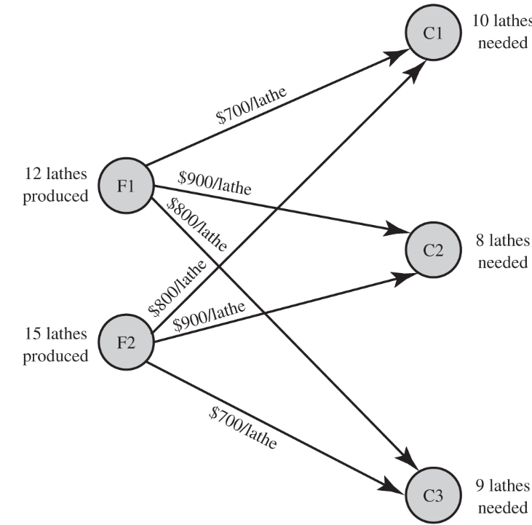
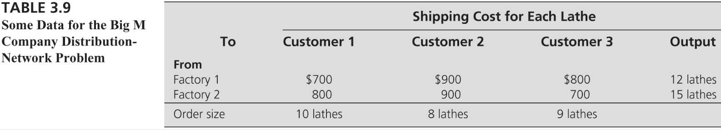
Transportation Problems
Case: Big M Company Transportation Problem (Chapter 3.5)
  Case Description: The Big M Company produces a variety of heavy duty machinery at two factories.
    One of its products is a large turret lathe.
    Orders have been received from three customers for the turret lathe.
  Question: How many lathes should be shipped from each factory to each customer?
STEP 0: Know the problem and gather your data

Slide 65
Transportation Problems
Case: Big M Company Transportation Problem (Chapter 3.5)
STEP 1: Decision variables
  We want to determine the shipment quantity
  from each factory to each customer
  S_{ij} = Number of lathes to ship from factor i to customer j (i= F1,F2, j=C1, C2, C3)
STEP 2: Objective and objective function
  We want to minimize the total cost
  Cost = $700S_{F1-C1} + $900S_{F1-C2} + $800S_{F1-C3} + $800S_{F2-C1} + $900S_{F2-C2} + $700S_{F2-C3}
STEP 3: Constraints
  Note that the total output is equal to the customer demand
    So, we will ship out all the output from each factory (2 constraints)
    And, we will ship exactly the demand to each customer (3 constraints)
    Hint: There are double ‘each’, so we might want to use double index

Slide 66
Transportation Problems
Case: Big M Company Transportation Problem (Chapter 3.5)
Combining everything (and not forgetting non-negativity constraints), we have the algebraic model as follows:
Minimize $700S_{F1-C1} + $900S_{F1-C2} + $800S_{F1-C3}
+ $800S_{F2-C1} + $900S_{F2-C2} + $700S_{F2-C3}
subject to
S_{F1-C1} + S_{F1-C2} + S_{F1-C3} = 12 (factory 1 output)
S_{F2-C1} + S_{F2-C2} + S_{F2-C3} = 15 (factory 2 output)
S_{F1-C1} + S_{F2-C1} = 10 (customer 1 demand)
S_{F1-C2} + S_{F2-C2} = 8 (customer 2 demand)
S_{F1-C3} + S_{F2-C3} = 9 (customer 3 demand)
S_{ij} >= 0 (non-negativity)
    Note: If the total output was greater than the total demand, factory constraints would be ‘<=‘ instead of ‘=‘.

Slide 67
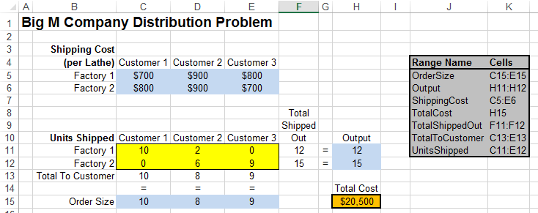
Transportation Problems
Case: Big M Company Transportation Problem (Chapter 3.5)
Spreadsheet model and solution with Excel Solver
Note that decision variables can be put into an array with multiple rows and multiple columns!

Slide 68
Transportation Problems
Integer Solutions Property: As long as all its supplies and demands have integer values, any transportation problem with feasible solutions is guaranteed to have an optimal solution with integer values for all its decision variables. Therefore, it is not necessary to add constraints to the model that restrict these variables to only have integer values.
Some variants of the transportation problems:
  The sum of the supplies exceeds the sum of the demands, so each supply represents a maximum amount (not a fixed amount) to be distributed from that source (We discussed how to use “<=“ instead of “=“ in supply constraints)
  The sum of the supplies is less than the sum of the demands, so each demand represents a maximum amount (not a fixed amount) to be received at that destination (One can try to minimize to total amount of shortages)
  Certain source–destination combinations cannot be used for distributing units (Simply we can force the shipment quantity between those to be 0)
  The objective is to maximize the total profit associated with distributing units rather than to minimize the total cost (Simply change the objective!)
  A destination has both a minimum demand and a maximum demand, so any amount between these two values can be received.
    Let’s solve an example

Slide 69
Transportation Problems
Case: Middletown School District Problem (Chapter 15.4)
  Case Description: Middletown School District is opening a third high school and thus needs to redraw the boundaries for the area of the city that will be assigned to the respective schools.
  The city has been divided into 9 tracts with approximately equal populations.
  Each school has a minimum and maximum number of students that should be assigned.
  The school district management has decided that the appropriate objective is to minimize the average distance that students must travel to school.
  Question: How many students from each tract should be assigned to each school?

Slide 70
Transportation Problems
Case: Middletown School District Problem (Chapter 15.4)
STEP 0: Know the problem and gather your data
 | Distance (Miles) to School
Tract | 1 | 2 | 3 | Number of High School Students
1 | 2.2 | 1.9 | 2.5 | 500
2 | 1.4 | 1.3 | 1.7 | 400
3 | 0.5 | 1.8 | 1.1 | 450
4 | 1.2 | 0.3 | 2.0 | 400
5 | 0.9 | 0.7 | 1.0 | 500
6 | 1.1 | 1.6 | 0.6 | 450
7 | 2.7 | 0.7 | 1.5 | 450
8 | 1.8 | 1.2 | 0.8 | 400
9 | 1.5 | 1.7 | 0.7 | 500
Minimum enrollment | 1,200 | 1,100 | 1,000
Maximum enrollment | 1,800 | 1,700 | 1,500

Slide 71
Transportation Problems
Case: Middletown School District Problem (Chapter 15.4)
STEP 1: Decision variables
  We want to determine the number of students from each tract assigned to each school
  S_{ij} = Number of students from tract i assigned to school j (i= 1,2…,9, j=1,2,3)
STEP 2: Objective and objective function
  We want to minimize the total distance travelled
  Total Distance = 2.2S₁₁ + … + 0.7S₉₃
STEP 3: Constraints
  Note that the total output is equal to the customer demand
    The students in each tract should be assigned to a school → 9 equality constraints
    The number of students assigned to a school should be between the minimum and maximum students that can be assigned to that particular school → 9 <= and 9 >= constraints
Practice formulating the algebraic model!

Slide 72
Transportation Problems
Case: Middletown School District Problem (Chapter 15.4)
Spreadsheet model and solution with Excel Solver

Slide 73
Assignment Problems
Typically, in an assignment problem:
  Given a set of tasks to be performed and a set of assignees who are available to perform these tasks, the problem is to determine which assignee should be assigned to each task.
  To fit the model for an assignment problem, the following assumptions typically need to be satisfied:
    The number of assignees and the number of tasks are the same.
    Each assignee is to be assigned to exactly one task.
    Each task is to be performed by exactly one assignee.
    There is a cost associated with each combination of an assignee performing a task.
    The objective is to determine how all the assignments should be made to minimize the total cost.

Slide 74
Assignment Problems
Case: Sellmore Company Problem (Chapter 3.6)
  Case Description: The marketing manager of Sellmore Company will be holding the company’s annual sales conference soon.
  He is hiring four temporary employees:
    Ann; Ian; Joan; Sean
  Each will handle one of the following four tasks:
    Word processing of written presentations
    Computer graphics for both oral and written presentations
    Preparation of conference packets, including copying and organizing materials
    Handling of advance and on-site registration for the conference
  Question: Which person should be assigned to which task?

Slide 75
Assignment Problems
Case: Sellmore Company Problem (Chapter 3.6)
STEP 0: Know the problem and gather your data
 | Required Time per Task (Hours)
Temporary Employee | Word Processing | Graphics | Packets | Registrations | Hourly Wage
Ann | 35 | 41 | 27 | 40 | $14
Ian | 47 | 45 | 32 | 51 | 12
Joan | 39 | 56 | 36 | 43 | 13
Sean | 32 | 51 | 25 | 46 | 15

Slide 76
Assignment Problems
Case: Sellmore Company Problem (Chapter 3.6)
Algebraic model:
STEP 1: Decision variables
  We want to determine the who does what
  X_{ij} = 1 if person i does job j
STEP 2: Objective and objective function
  We want to minimize the total cost
STEP 3: Constraints
  Each person does one task → 4 constraints
  Each task is done by one person → 4 constraints
  We will learn about binary variables later!

Slide 77
Assignment Problems
Case: Sellmore Company Problem (Chapter 3.6)
Algebraic model:
    Minimize 490X(A,1)+574X(A,2)+378X(A,3)+560X(A,4)
    +564X(I,1)+540X(I,2)+384X(I,3)+612X(I,4)
    +507X(J,1)+728X(J,2)+468X(J,3)+559X(J,4)
    +408X(S,1)+765X(S,2)+375X(S,3)+690X(S,4)
    Subject to X(A,1)+X(A,2)+X(A,3)+X(A,4)=1
    X(I,1)+X(I,2)+X(I,3)+X(I,4)=1
    X(J,1)+X(J,2)+X(J,3)+X(J,4)=1
    X(S,1)+X(S,2)+X(S,3)+X(S,4)=1
    X(A,1)+X(I,1)+X(J,1)+X(S,1)=1
    X(A,2)+X(I,2)+X(J,2)+X(S,2)=1
    X(A,3)+X(I,3)+X(J,3)+X(S,3)=1
    X(A,4)+X(I,4)+X(J,4)+X(S,4)=1
    X(i,j)>=0
Transportation problem!!
No need to force Xij’s to be binary → recall the integer solutions property of transportation problems!

Slide 78
Assignment Problems
Case: Sellmore Company Problem (Chapter 3.6)
Spreadsheet model and solution with Excel Solver

Slide 79
Assignment Problems
Case: Middletown School District Problem Revised (Chapter 15.7)
  Case Description: Recall the case
  Now, tract splitting is no longer allowed
    That is, the students from the same tract should be assigned to the same school!
  Also, each school should be assigned equal number of tracts
    That is, each school will cover 3 tracts
  So the Middletown School District problem becomes a variant of an assignment problem
  Question: Which tract should be assigned to which school?

Slide 80
Assignment Problems
Case: Middletown School District Problem Revised (Chapter 15.7)
Spreadsheet model and solution with Excel Solver

